Slide 1
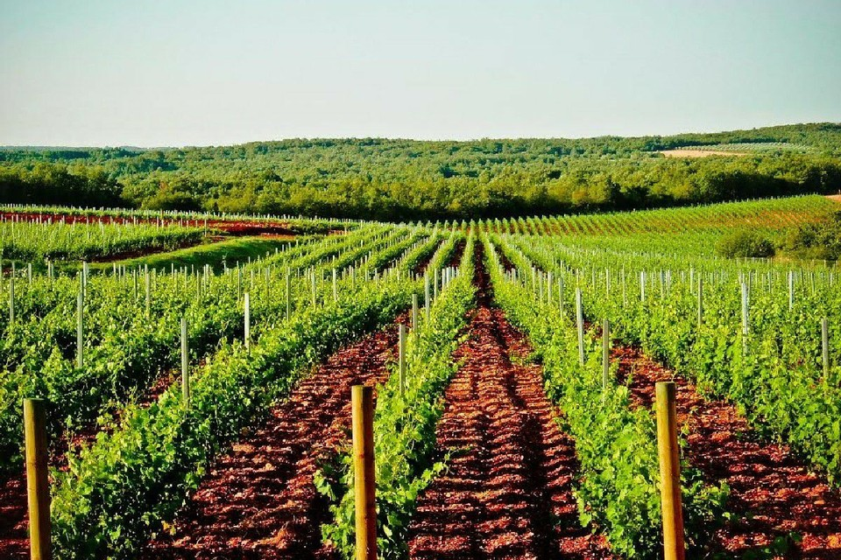
Project partners

Slide 2
COORDINATOR OF PROJECT
Lions Distrikt 126
COUNTRY AND CITY WHERE THE PROJECT IS CARRIED OUT
Croatia, Ilok, Vinogorje Iločkih podruma, područje Vukovo
LVD COMMITTEE
President: Marina Kralj Miliša, members: Ilijana Palčec,
Vesna Boinović Grubić, Sanja Matovina Lulić,
Lidija Crnčević,Frano Mika,Jozo Berečić, Željko Marić
LVD COMMITTEE IN BORDEAUX
Vesan Boinović Grubić, Dražen Melčić, Željko Gucunski
PROJECT GOAL
humanitarian activities of Lions in new environments, encouragement of education for the acquisition of agro-agricultural qualifications for the development of the economy of Eastern Slavonia
PURPOSE OF THE PROJECT
donate every year funds for ecological actions, education of school students and students of agronomic orientation and scholarships for studies
INDIRECT AID
promotion of the destination of the war-affected Vukovar, Ilok (hotel stay,
visit to museums, promotion of enogastronomy of the Vukovar-Srijem County.

Slide 3
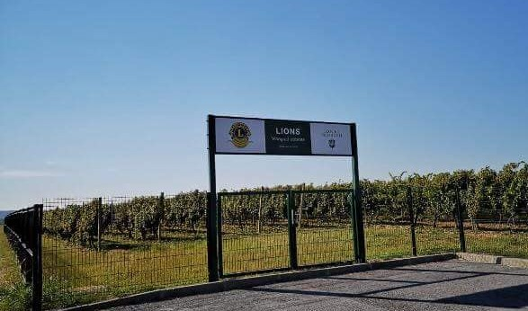
ACHIEVEMENTS
So far 11 000 euros has been donated to Ilok High School.
Harvesting of vineyards, togetherness and fellowship of over 100 Lions of the region.
Promotion of the destination of Vukovar-Srijem County.
More than 40 clubs from Croatian Lions district 126 are well involved in the Lions Vineyard project, and more than 15 countries are involved internationally, including clubs and individuals from the following countries: Slovenia, Serbia, Italy, Macedonia, Bosnia and Herzegovina, Germany, Greece, Estonia, Lithuania, England , USA, Netherlands, Austria, Hungary and Sweden
Fenced vineyard, inscription "LIONS VINEYARD OF GOODNESS"

Slide 4
ACTIVITIES
1. Promote the project nationally at Lions District 126 club meetings, cabinets and conventions
2. International promotion at Lions Europa forums: Skopje, Tallinn, Thessaloniki, Zagreb
3. International promotion at Lions conventions in world
4. Participation in harvests every year in September
5. Gathering of Lions of Croatia and Lions of Europe

Slide 5
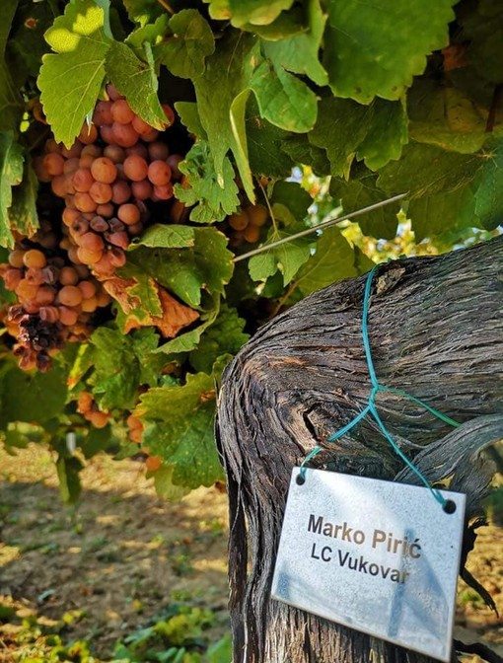
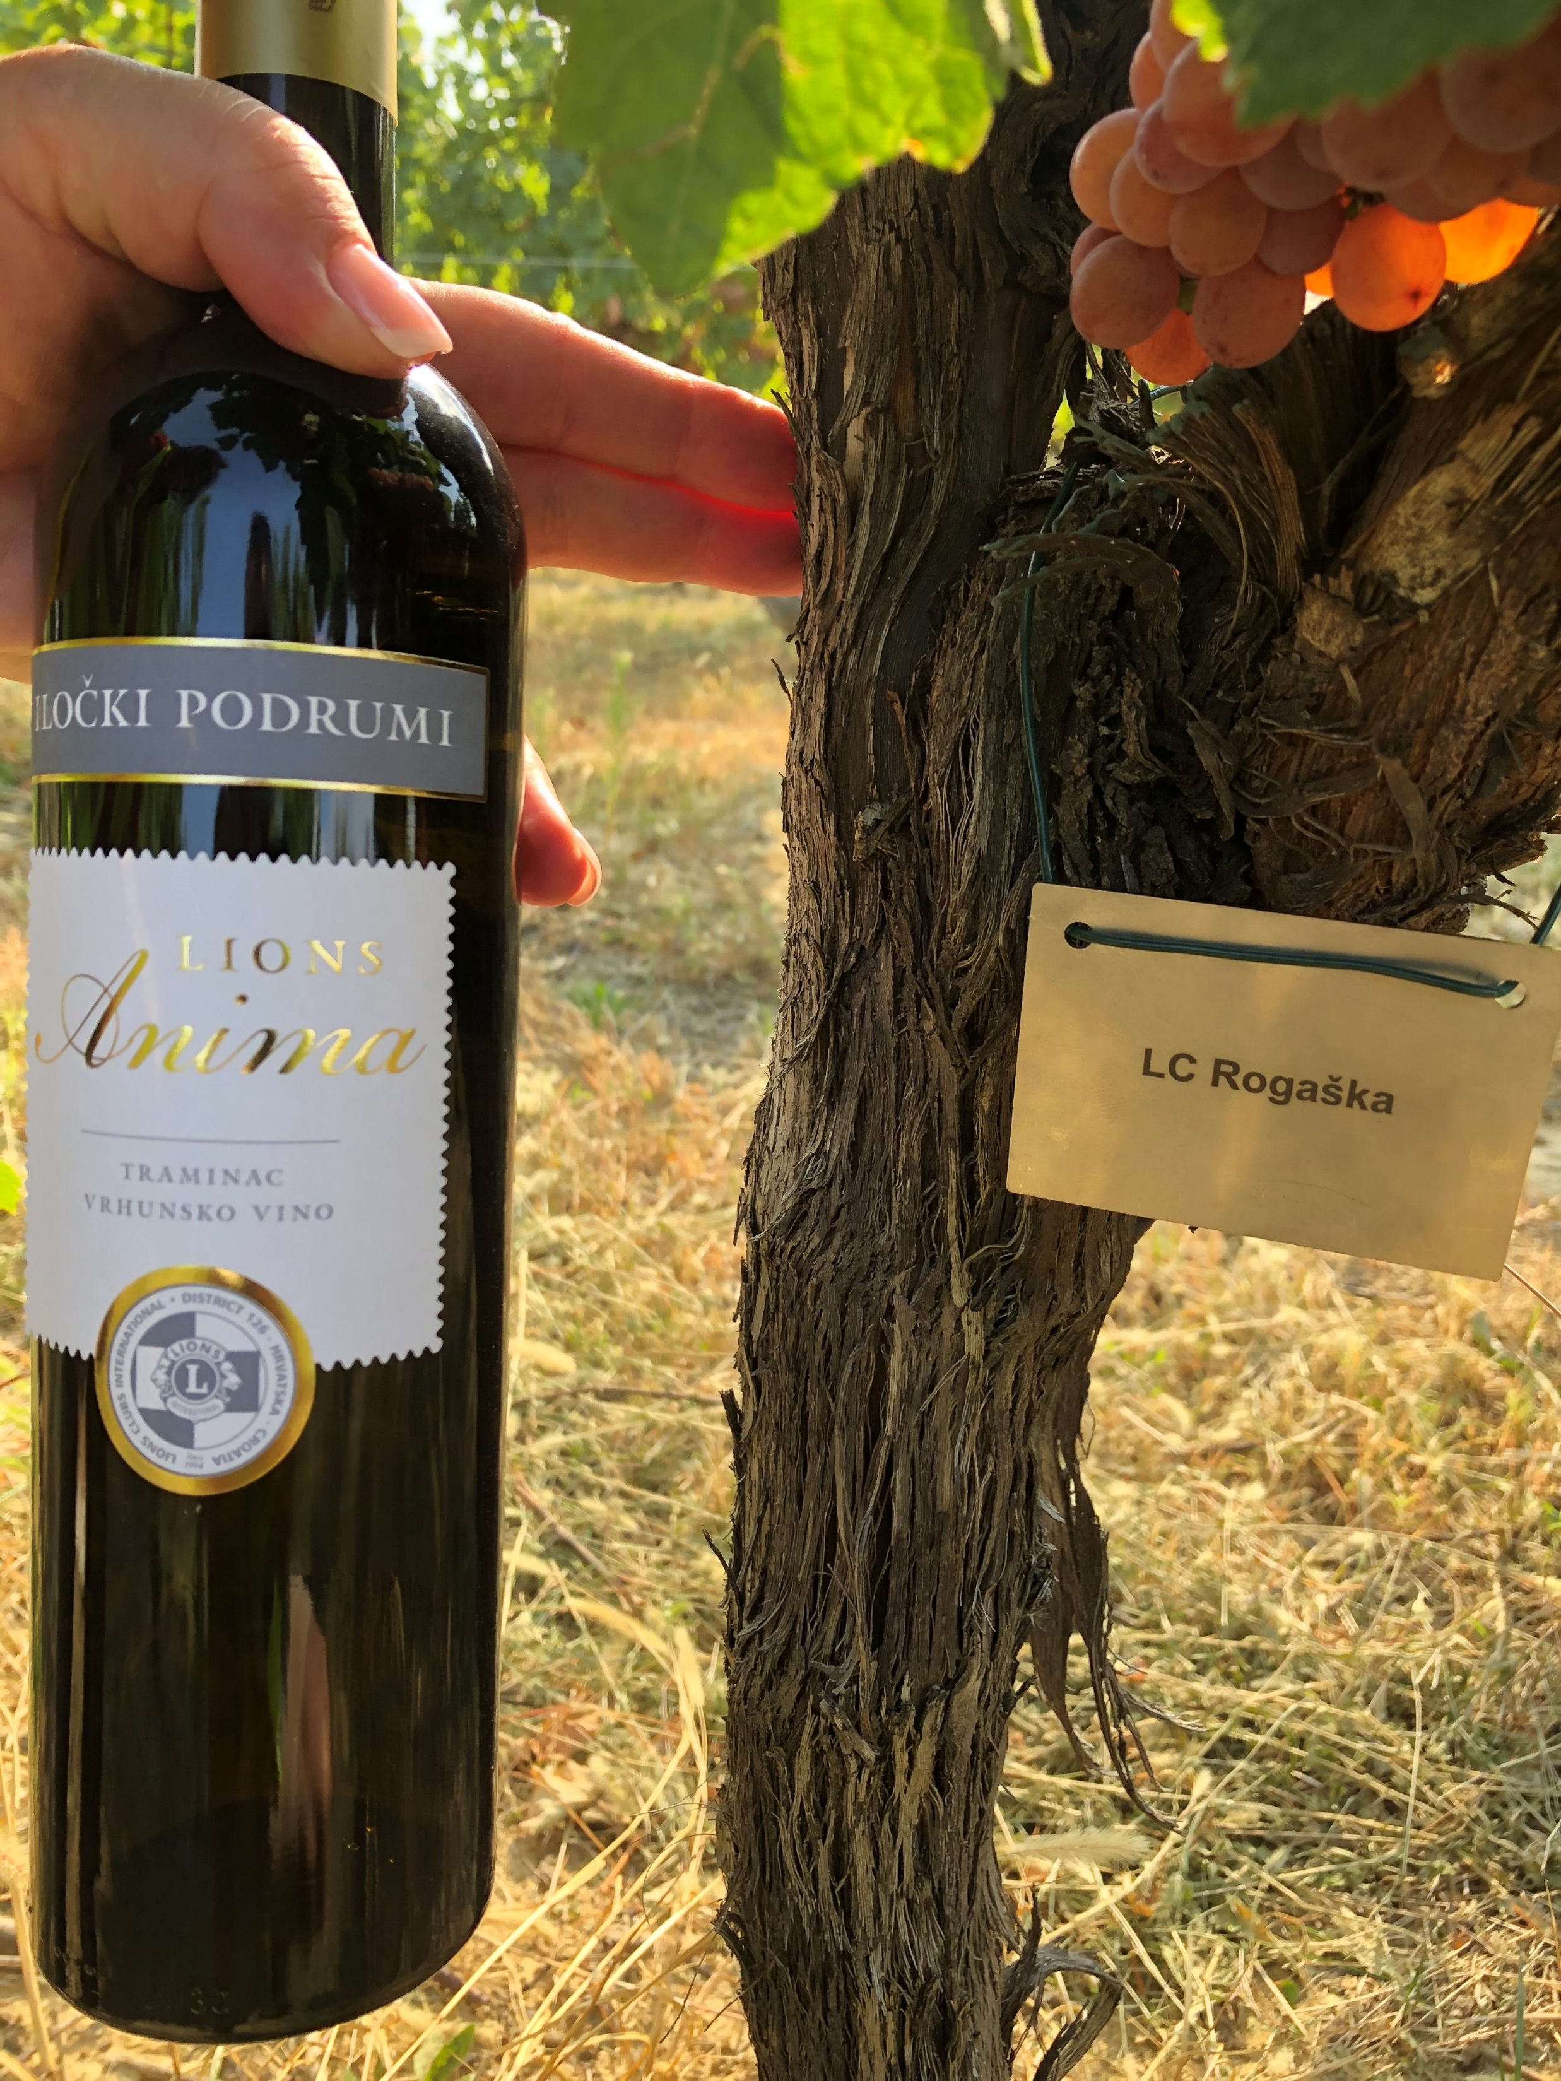
DONATIONS
How to become the godfather of the Lions Vineyard of Kindness?
Each donor acquires the right to:
– stainless steel plate with name and surname (as in picture)
- a charter of sponsorship
- six (6) bottles of premium Lions Anima traminer

Slide 6
Support "Lions Vineyard of Kindness" with a donation of 70,00 euros to the following account: IBAN:
HR 7823600001503435916 SWIFT:ZABAHR2X

Slide 7
SPONSORSHIP
1,000 traminer vines are waiting for 1,000 new donors who will help with their generous donations to young people for acquiring and applying knowledge useful for the development of the economy of Eastern Slavonia

Slide 8
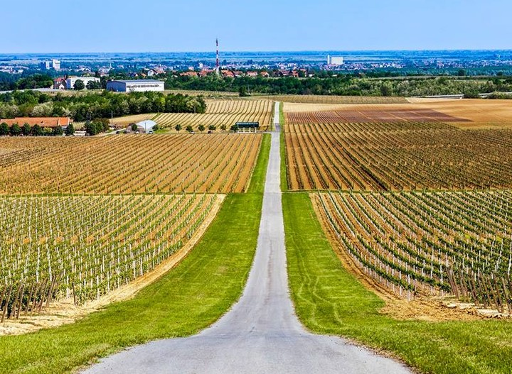
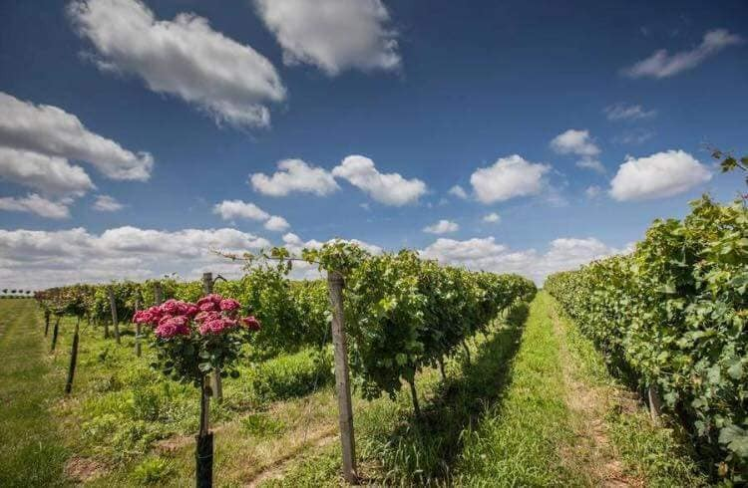
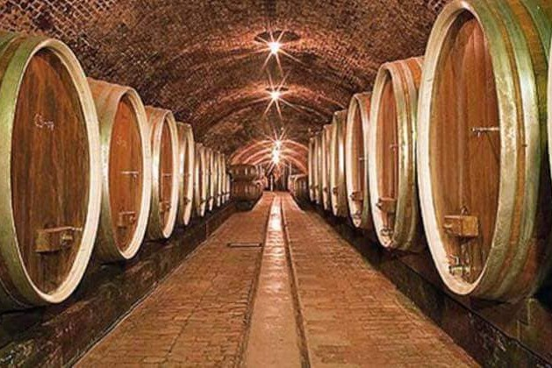

Slide 9
Thank you for attention!:)
https://youtu.be/emiXAEHp6Sk?si=dznveKNfYfWi2qPR
Place a plaque with your name on the selected vine and enjoy the golden drops of the premium Lions Anima traminac with the joy of generosity!

