Slide 1
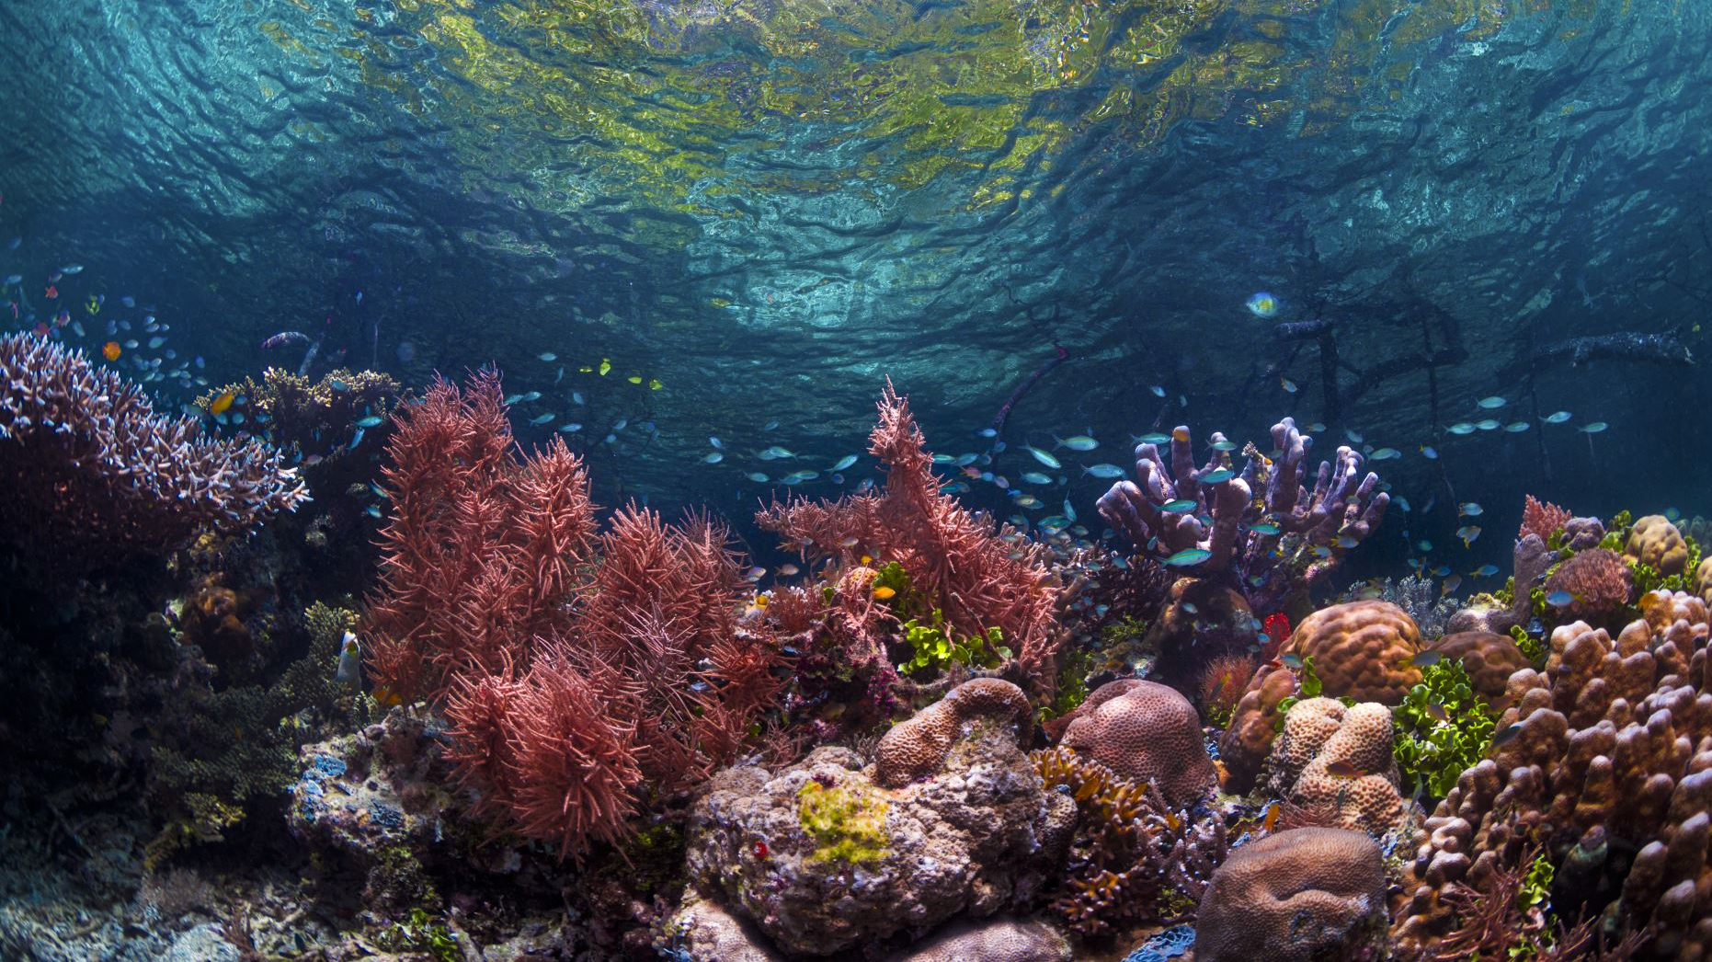
impact of microplastics on marine ecosystems
Lions Ecological action „Sea”
AsSoc.prof. PHD Sanja Kalambura

Slide 2
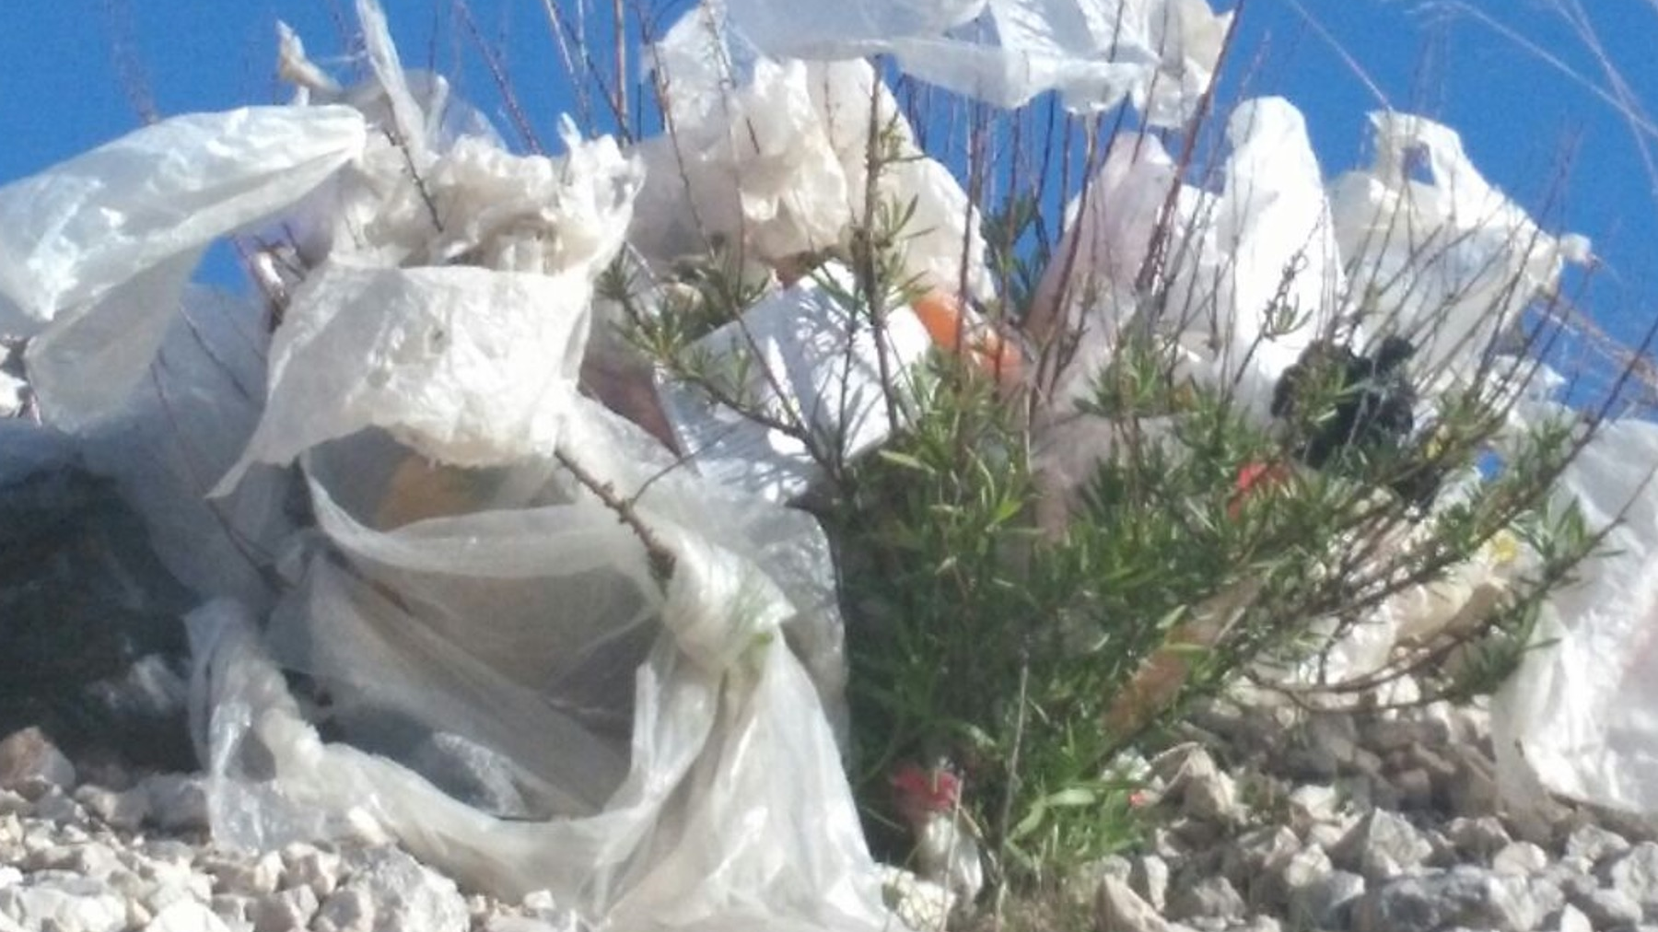

EVERY DAY, EACH OF US LEAVES A TRACE IN THE WORLD THAT SURROUNDS HIM.
WHAT YOU DO, CAN BRING A CHANGE, AND IT IS UP TO YOU TO DECIDE WHAT IT WILL BE LIKE!
JANE GODAL

Slide 3
EUROPEAN UNION AND ENVIRONMENTAL POLICIES
Since the second half of the 1970s, the European Union's environmental policy has been guided by action programs with priority objectives that need to be ensured over a period of time
In 2013, the European Parliament and the Council of the European Union adopted the seventh Environmental Action Program, which covered the period up to 2020 with a projection to 2050

Slide 4
BASIC MASSAGE OF THE 7th ACTION Program - 2050!
To live well within the ecological constraints of the planet
01
Ensure the healthy environment which should come from an innovative circular economy in which nothing is lost and in which natural resources are managed in a sustainable way
02
It is important to protect biodiversity, to strengthen the resilience of our society
03
Low CO₂ emissions should be the basis for a secure and sustainable global society
04

Slide 5
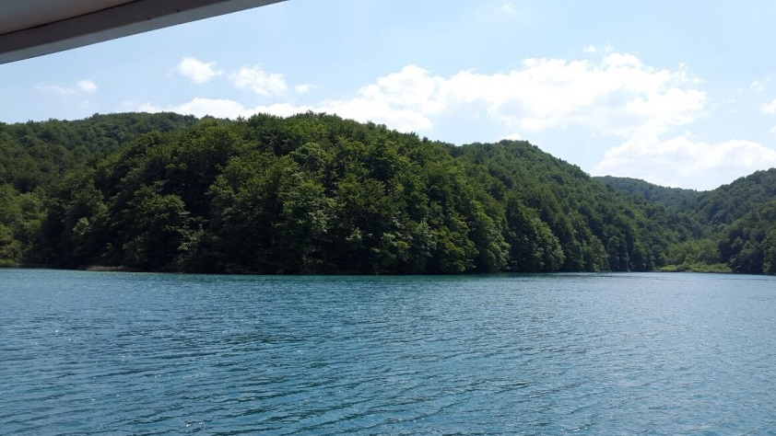
EU environmental objectives
Protect, preserve and increase the Union's natural capital
Turn the Union into a resource-efficient, green and competitive economy with low CO₂ emissions
Protect Union citizens from environmental pressures and threats to their health and well-being
Increase environmental knowledge and expand the evidence base for better policy-making

Slide 6
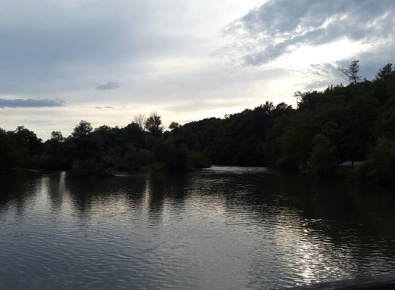
EU environmental objectives
Increase the involvement of environmental issues in policy decisions and ensure coherence
Improve the sustainability of cities in the Union when creating new policies
Increase the Union's effectiveness in addressing international environmental and climate challenges

Slide 7
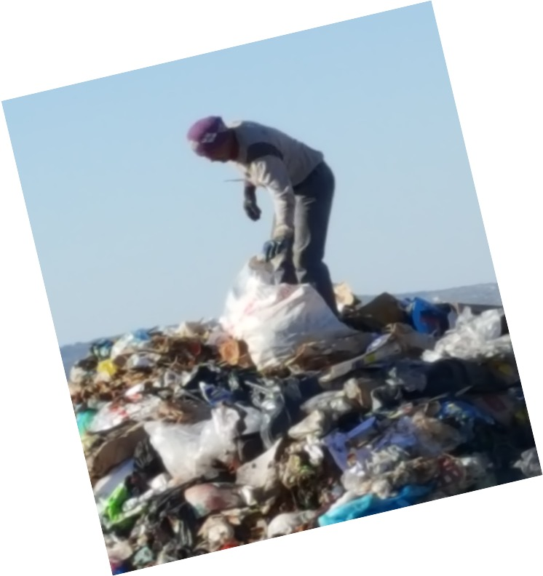
Protecting and preserving the environment is a necessary condition not only for sustainable development, but in many parts of the Earth and for the survival of the community
POLITICAL AND SOCIOLOGICAL MEASURES
LEGAL MEASURES
SPACE PLANNING
ECONOMIC AND FINANCIAL MEASURES
SCIENTIFIC APPROACH ANDTECHNOLOGICAL MEASURES
INSTITUTIONAL MEASURES
Environmental standards

Slide 8
Environmental standards
Environmental standards are often not comparable with each other, so a significant problem is converting scales into comparable sizes.
It is important to know that economic measures can be expressed in monetary terms, but environmental measures are difficult to convert into monetary indicators.
Therefore, the criteria are expressed by certain norms or "weight" of individual indicators in relation to the desired goals

Slide 9
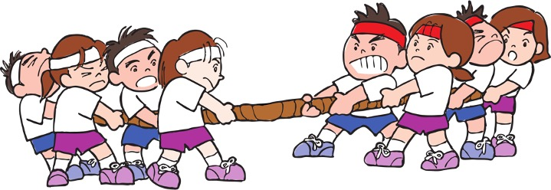
Can we manage environmental problems?
www.openclipart.org
NIMBY
NIMO
BANANA
IDEOLOGies
Bussines interest
Coruption
Criminal

Slide 10
Where does the OUR AWARENESS process begin and end?
Decision making
Informations

Slide 11
Where does the OUR AWARENESS process begin and end?
Every day we are confronted with information through the media that calls us to change in terms of waste, but have we changed anything in ourselves?
1
What exactly is the motivating factor that drives us in terms of waste-related changes?
2

Slide 12
Where does the OUR AWARENESS process begin and end?
Each of us will choose consciously or unconsciously what is most acceptable to him in the pattern of his own behavior.
But is that enough for us to initiate the whole series of changes that are before us in terms of preserving the environment?
An important role in the process of spreading ideas is played by the media, but also by individual activities such as actions
Actions such as the "SEA" action are word of mouth

Slide 13
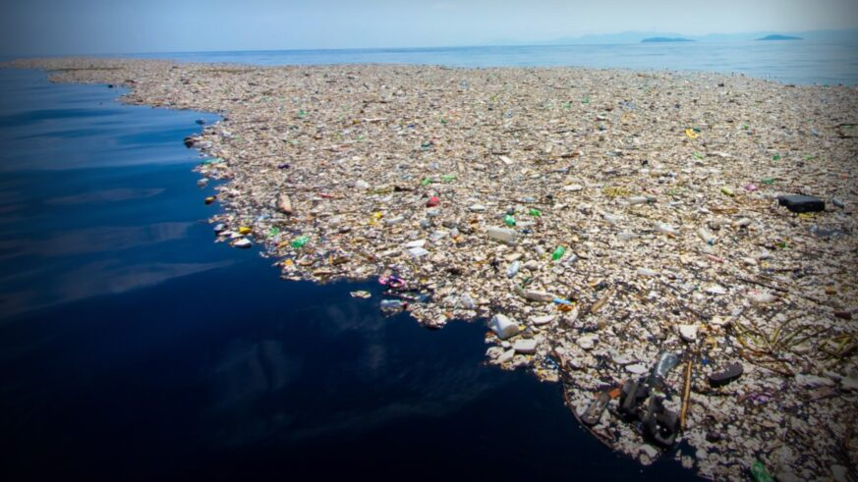
Sea and oceans
new horizons
www.inteligentliving.co

Slide 14
Polymers / plastics in everyday life
Plastic is an artificial material that we cannot find in nature in such a form
It is created by a chemical polymerization process
It is mainly produced from crude oil and natural gas
Plastic is light, durable, resistant to moisture
PET packaging is the most commonly used
Highly valuable material that we do not appreciate at all!

Slide 15
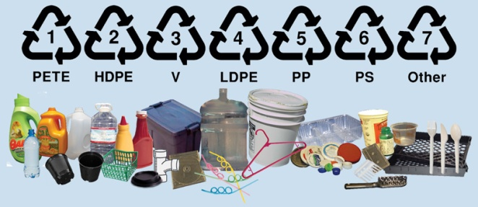
Izvor: www.nanoplastic.wordpress.com

Slide 16
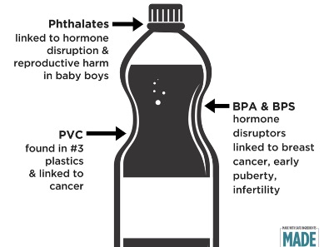
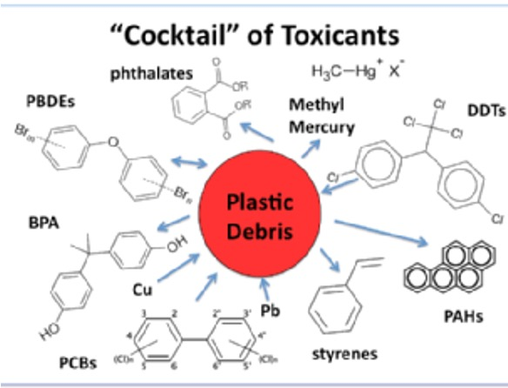
What are the dangerous components in plastic?
www.madesafe.org
Carbon and nano particles
A concentration of plastic nanoparticles of 100 milligrams per liter of water causes the extinction of algae
Bisphenol A (BPA)
Bis(2-ethylhexyl) phthalate (DEHP)
Benzyl butyl phthalate (BBP)
Dibutyl phthalate (DBP)
Diisobutyl phthalate (DIBP)
www.association for denman island marine stewards

Slide 17
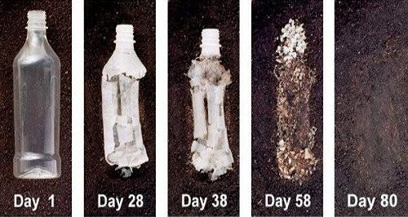
Europe produces 50 million tons of various polymer materials and is the second largest plastic producer in the world
Plastic packaging makes up almost 40% of all plastic waste
Approximately 8 to 20 million tons of plastic are released into the oceans each year
According to the study "Plastic pollution in the World's Oceans: More than 5 Trillion Plastic Pieces ..." there are already more than 5 trillion pieces of plastic waste in the oceans
www.echoinstruments.eu

Slide 18
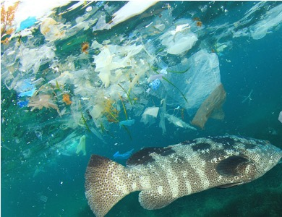
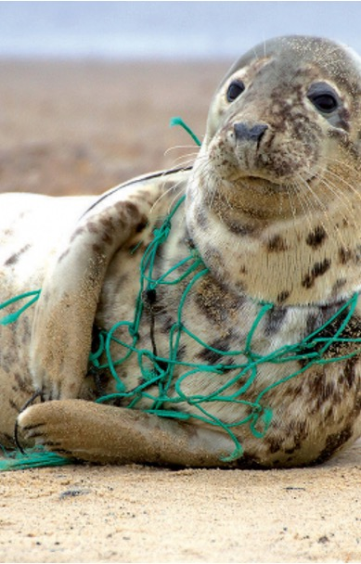
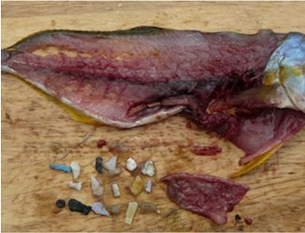
www.givingcompas.org
The effects that plastics have on ecosystems
www.scientificamerican.com
www.journalsopenedition.org

Slide 19
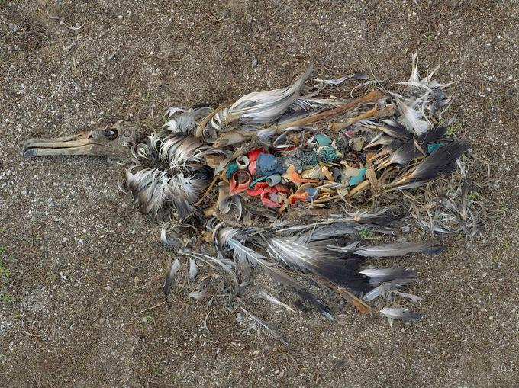
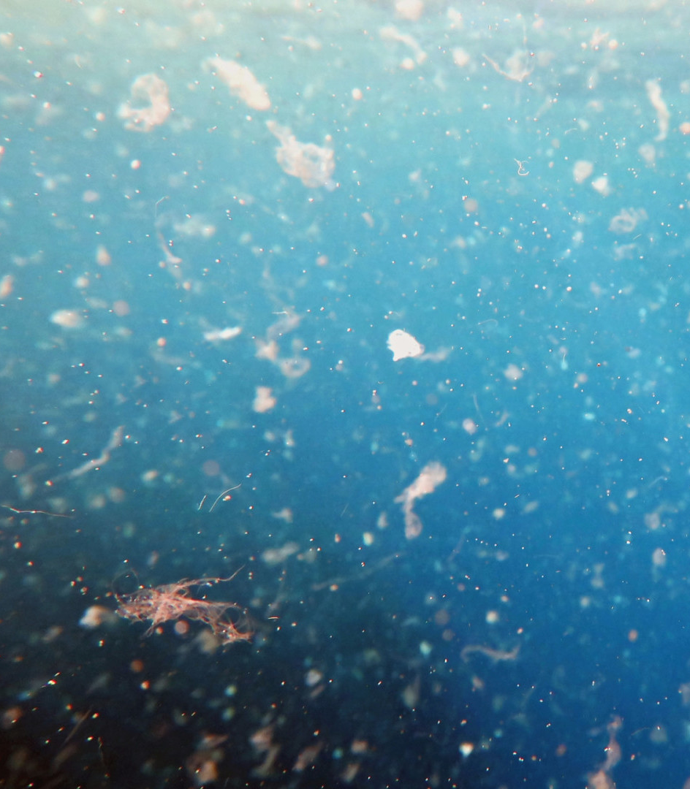
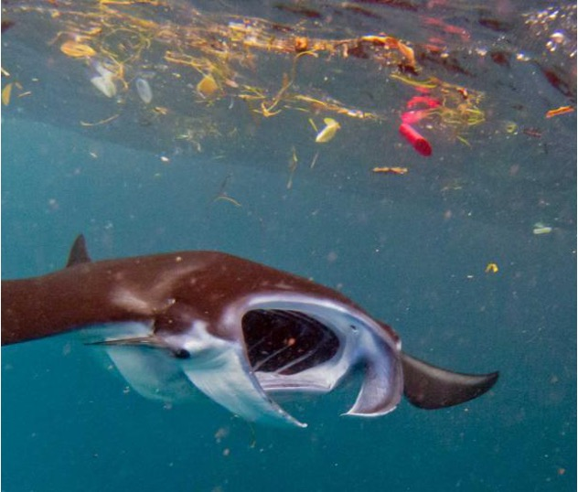
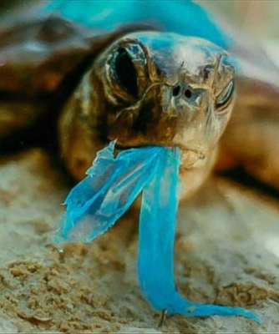
www.brown.edu.com
www.asianwater.com.my
The effects that plastics have on ecosystems
www.brenmicroplasticweebly.com
www.dw.com

Slide 20
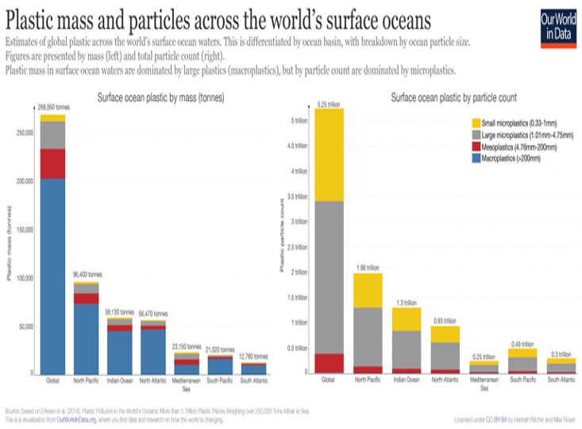
H. Ritchie, M. Roser (2019) Plastic Pollution. Published online at OurWorldInData.org. Retrieved from: 'https://ourworldindata.org/plastic-pollution' [Online Resource]

Slide 21
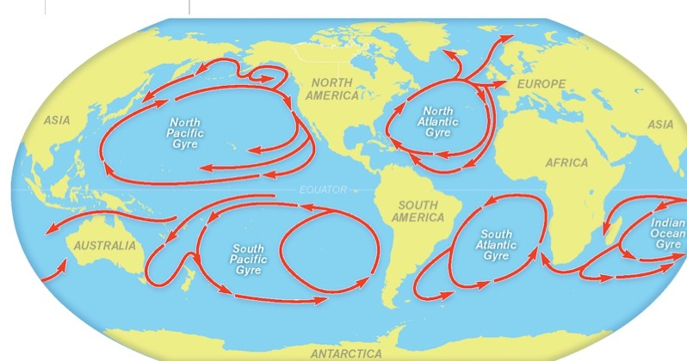
www.scienceworld.scholastic.com

Slide 22
What are the negative properties of plastic?
Adsorption
They react with contaminants
It's hard to wash!

Slide 23
WHAT IS A MICROPLASTic?
Pollution in the form of tiny plastic particles smaller than half a centimeter which, when found in the sea or sediment, represent an almost invisible but dangerous form of pollination
It enters the food chain very easily
According to the UN, there are 51 trillion microplastic particles in the seas, 500 times more than the number of stars in our galaxy
Serves as a carrier of various toxic substances

Slide 24
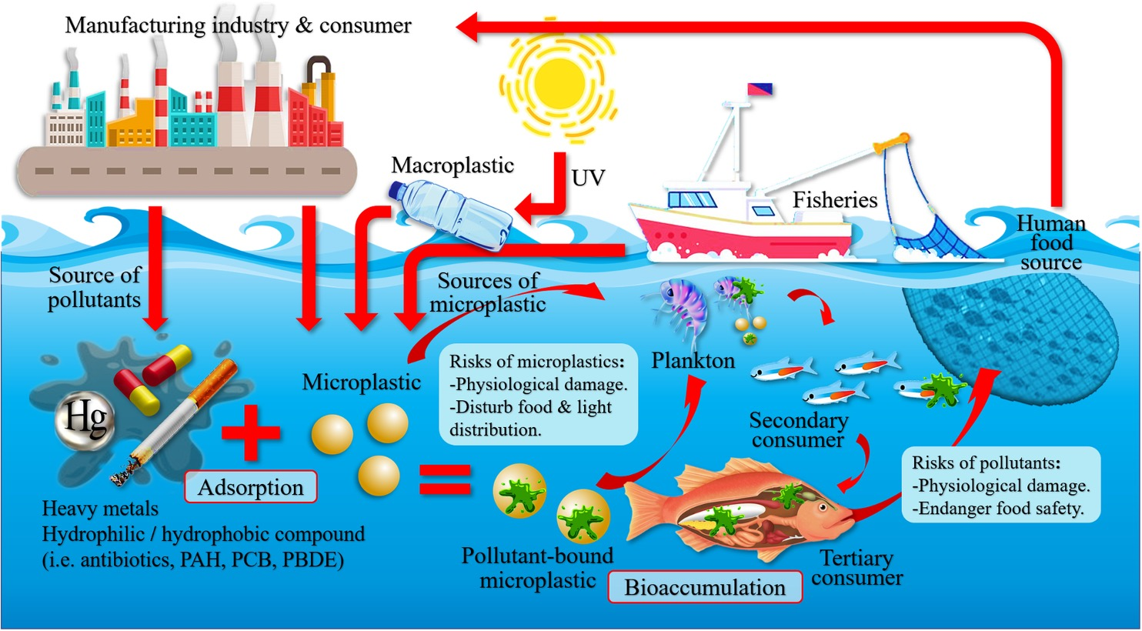
https://progearthplanetsci.springeropen.com/articles/10.1186/s40645-020-00405-4

Slide 25
Primary and secondary microplastics
Primary microplastics
It is intentionally added to products and thus released into the environment - 15-31% of microplastics in the seas
Main sources: wear of synthetic clothing (35% of primary microplastics), consumption of car tires (28%) and face and body care products (eg microparticles used in exfoliating products, 2%)
Secondary microplastics
It makes up 69-81% of microplastics in the seas It is formed by the disintegration or decomposition of larger pieces of plastic such as bags, bottles and fishing nets

Slide 26
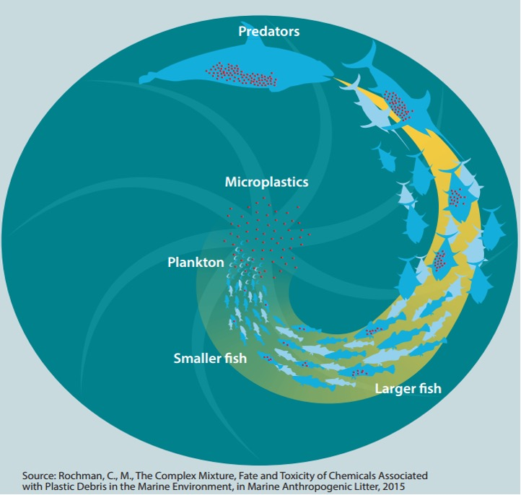
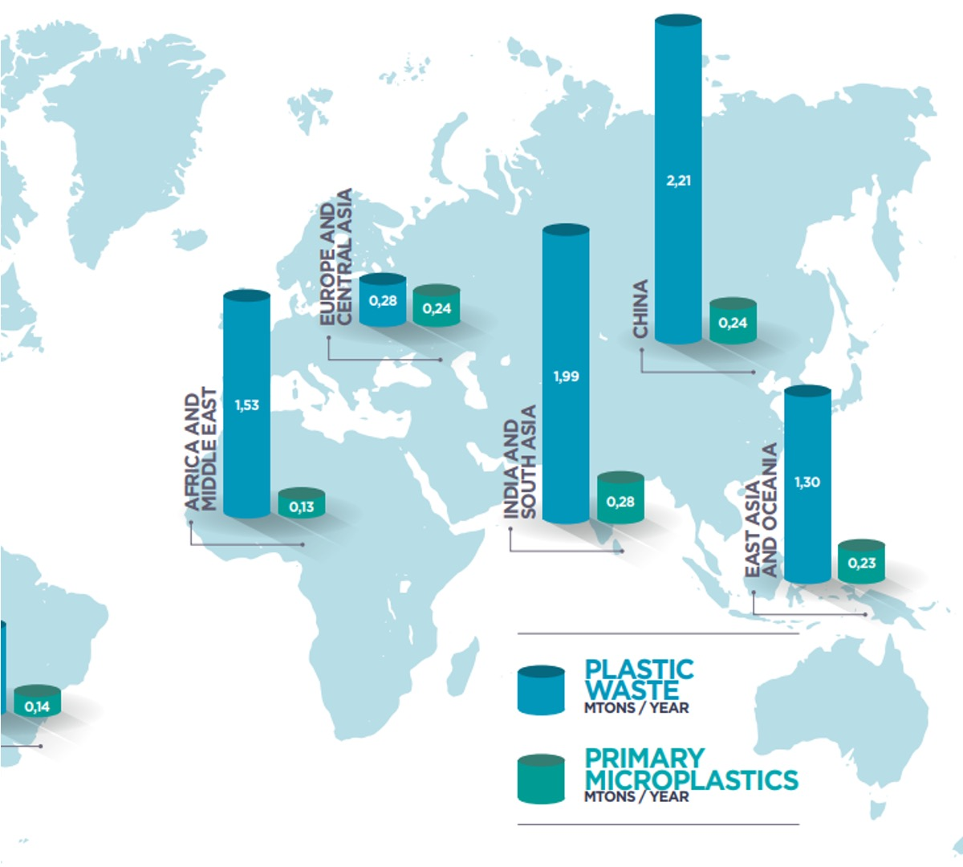
Boucher, J. and Friot D. (2017). Primary Microplastics in the Oceans: A Global Evaluation of Sources. Gland, Switzerland: IUCN. 43pp

Slide 27
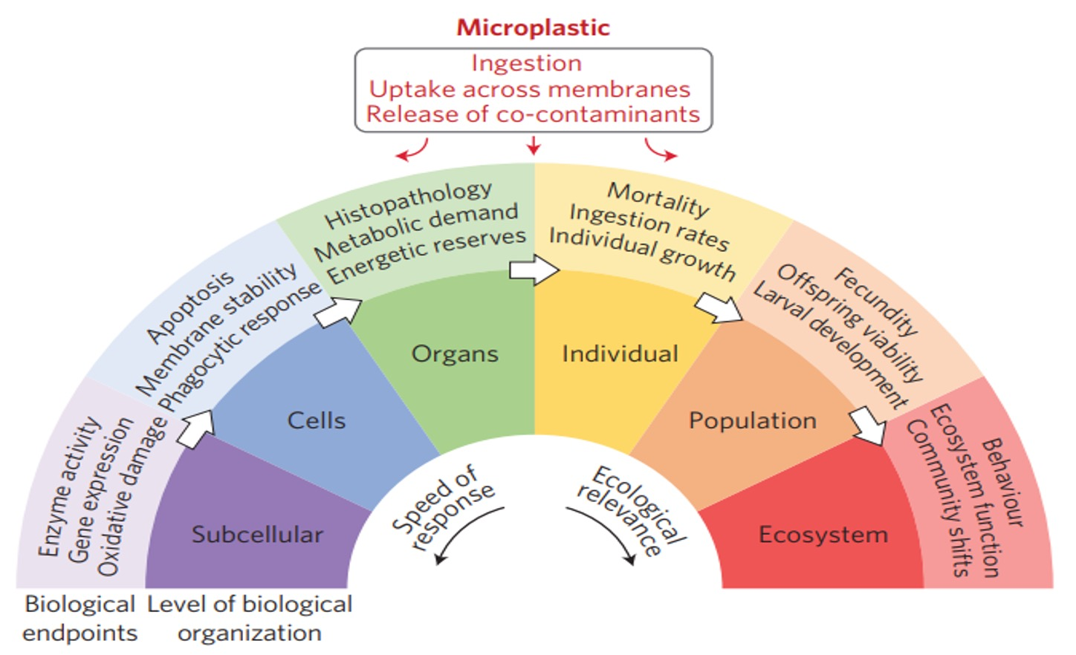
H. Ritchie, M. Roser (2019) Plastic Pollution. Published online at OurWorldInData.org. Retrieved from: 'https://ourworldindata.org/plastic-pollution' [Online Resource]
T. S. Galloway, M. Cole, C. Lewis. Interactions of microplastic debris throughout the marine ecosystem. Nature Ecology & Evolution. (2017.) 1(0116).
Pojednostavljen prikaz potencijalnih učinaka izloženosti mikroplastici

Slide 28
Microplastics in the Adriatic sea
The international DeFishGear project has begun the path of systematic research into the quantities and distribution of microplastics in the Adriatic
The so-called "Manta nets" - special nets made of a solid metal frame to which a net with a diameter of one third of a millimeter is attached - the net is pulled over the surface, and its content is later analyzed
From 3 to 7 microplastic particles are located per square kilometer in the central and southern Adriatic

Slide 29
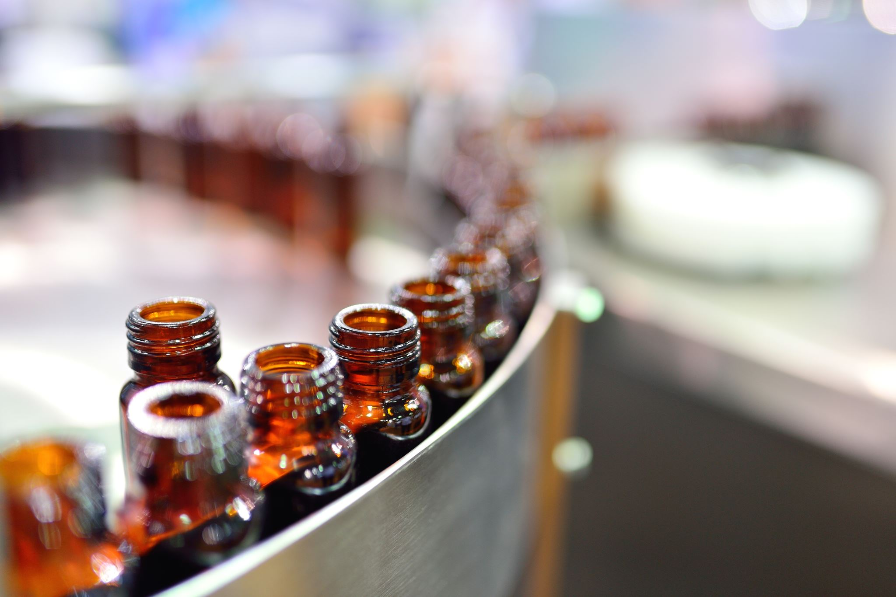
Proposals for Strategic Solutions at the EU level
Plastics strategy - by 2030, plastics must be recyclable
A ban on microplastics in cosmetics is sought
The introduction of quality standards for recycled plastics is encouraged

Slide 30
Where does the OUR AWARENESS process begin and end?
By sending public messages to the general public, ie to all members of society, their opinion is created
The choice of the topic is very important, ie the content of the message, but also the context in which individual topics are presented
The very choice of content determines what people will form an opinion about
The content they present and the way it is presented greatly influences our attitudes and mood, so today they are actually the main means of directing and shaping the attitudes of citizens.

Slide 31
Where does the OUR AWARENESS process begin and end?
Waste management is, unfortunately, a very little represented topic in the media It is said that what is not in the media, does not even exist
Due to the lack of information, citizens are not even aware of how important proper waste management is and how each individual with small changes (such as waste separation, instead of throwing in the trash) greatly contributes to the well-being of all citizens
"Green" topics are not bombastic enough to sell newspapers, so their media space is taken up by another colour, ie "yellow"

Slide 32
How to achieve the desired results and better motivation?
Define clear and targeted surveys of public attitudes in order to determine the initial state, ie the level of information and understanding of certain areas of waste management
In evaluating the results, it is important to distinguish the results from the outcomes, because certain information materials are only a means to achieve the expected outcomes: better information, adoption of new habits, changes in behavior

Slide 33
Conclusion!
On the end, the conclusion is that education is an indispensable measure and driver of all activities within the entire waste management system
Successful motivation is always a combination of the positive method (carrot) and the negative (whip) method
Waste is ultimately a cross-border problem - it depends on good regional and international cooperation
A solution for marine litter should be find on land
It is necessary to develop technologies and ways of collecting microplastics from water surfaces
Develop methods for sampling, processing and identification of microplastics of 1–20μm size Improve wastewater treatment technologies
Start thinking about a new problem, and that is - Nanoplastics?

Slide 34
Thank you! sanja.kalambura@vvg.hr
“” The secret of change is to focus all of your energy, not on fighting the old, bud on building the new.”
Socrates

